Slide 1
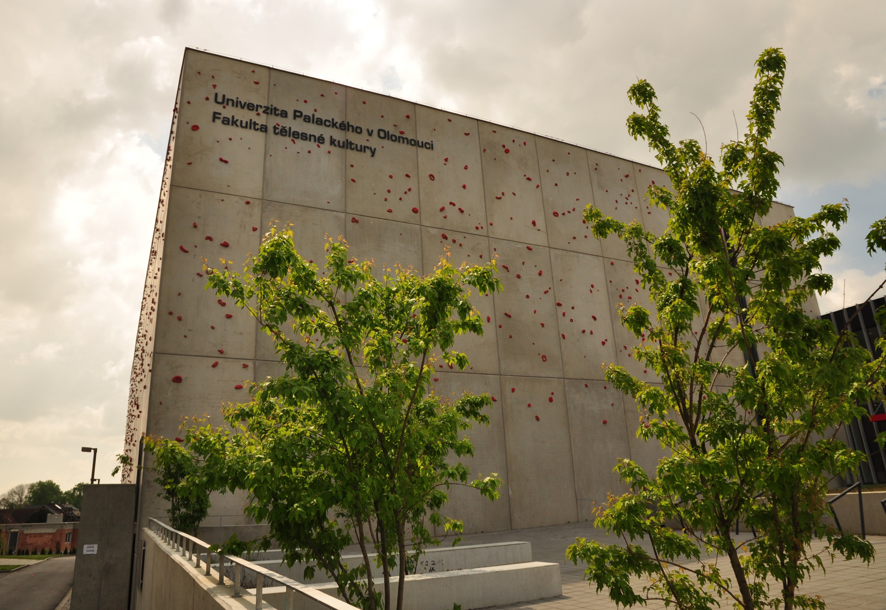



Swimming Summer School in Olomouc
Southwest University, Chongqing, China
July 17-30, 2017

Slide 2

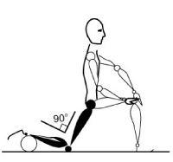
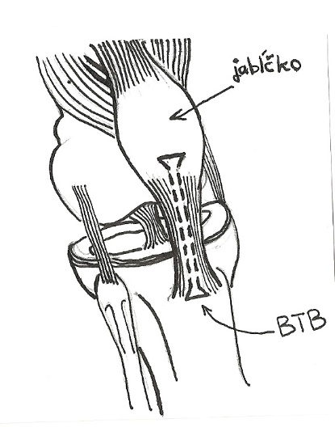
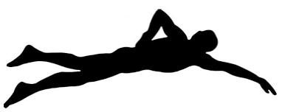

Organization of swimming camp
WE OFFER ACTIVITIES FOCUSED ON:
„Development and innovation of swimming technique using camera system“
„Use of specific diagnostics focused on needs of particular sports – swimming“

Slide 3
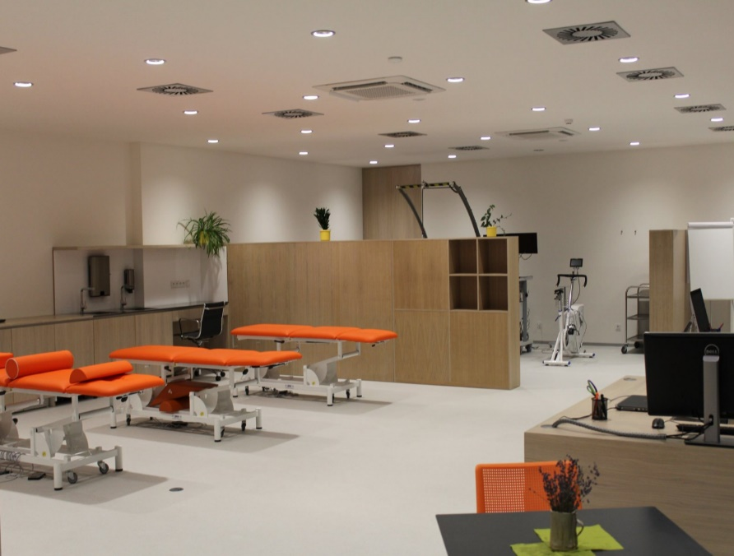
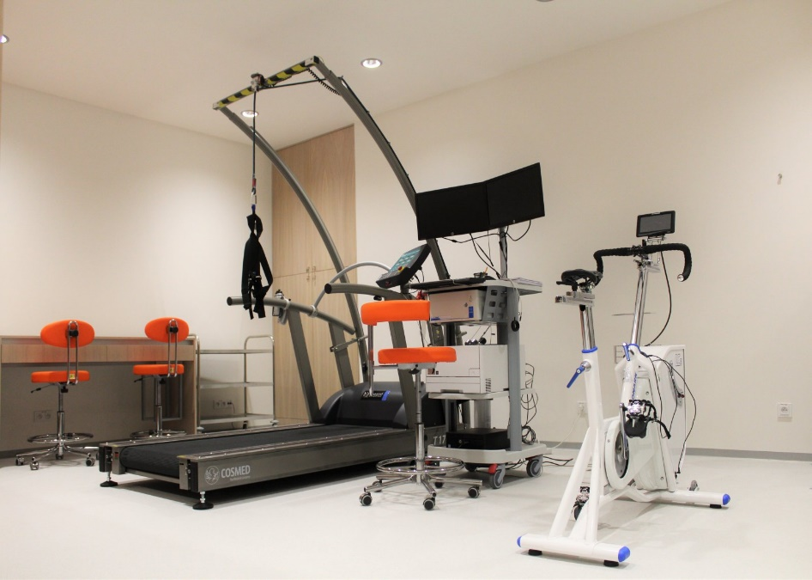
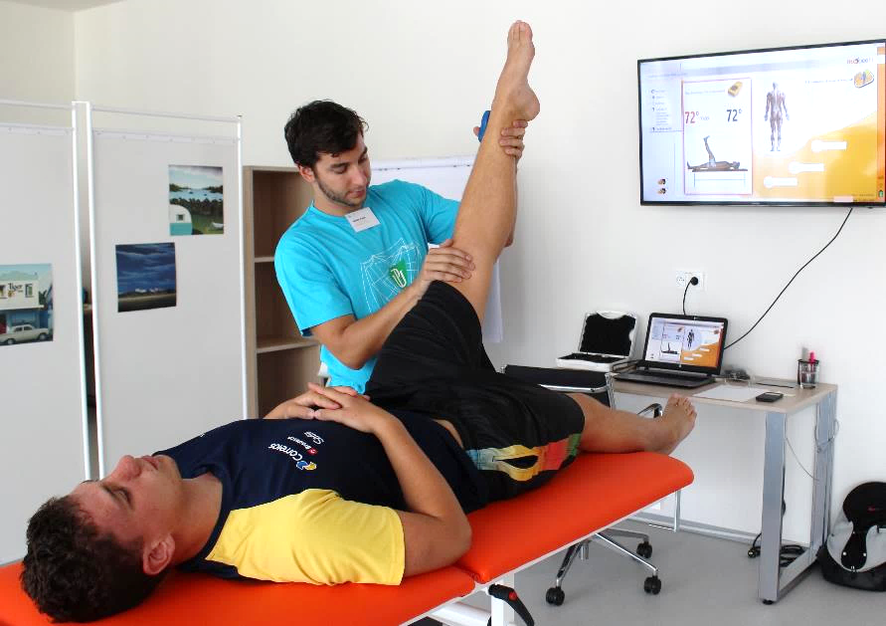
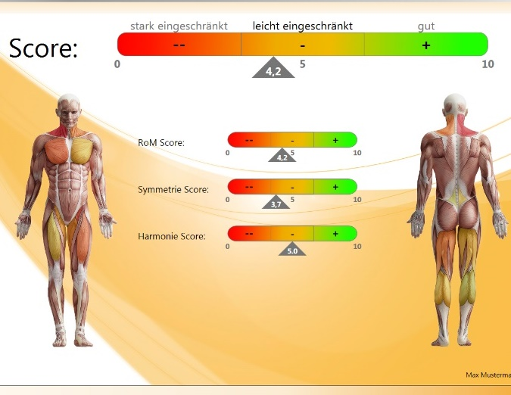
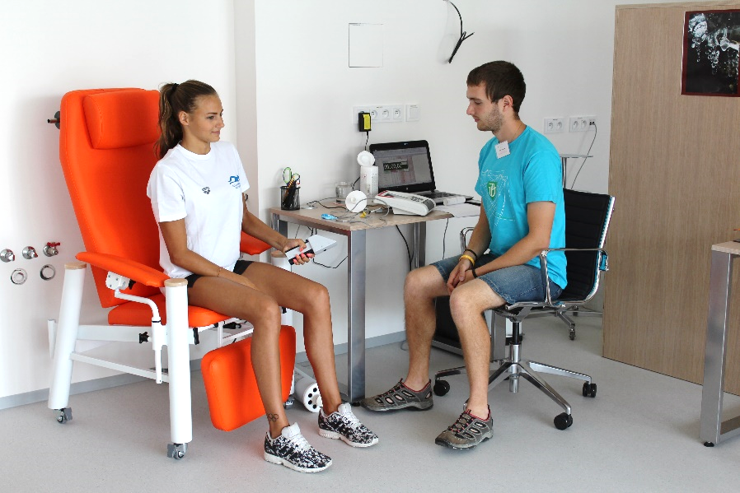
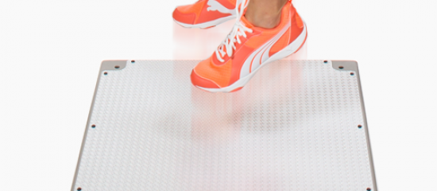
Diagnostic tests
Offer of specific swimming diagnostics
SUGGESTED TESTS FOR SWIMMING:
Body composition – muscle and fat mass, body water, etc.
Mobility measurement – identifying muscle dysbalances
Explosive power of lower limbs – preconditions for power of lower limbs and take-off
Testing balance and coordination – injury prevention, harmony of movements
Forearm strength – assessment of forearm strength, important for swimming technique
Spirometry – rest volume and capacity of lungs
Measurement of condition of vessels, stress and autonomic nervous system
Lactate curve – training load
Printed or electronic feedback possible.
Individual or team output with result interpretation or recommendation.

Slide 4
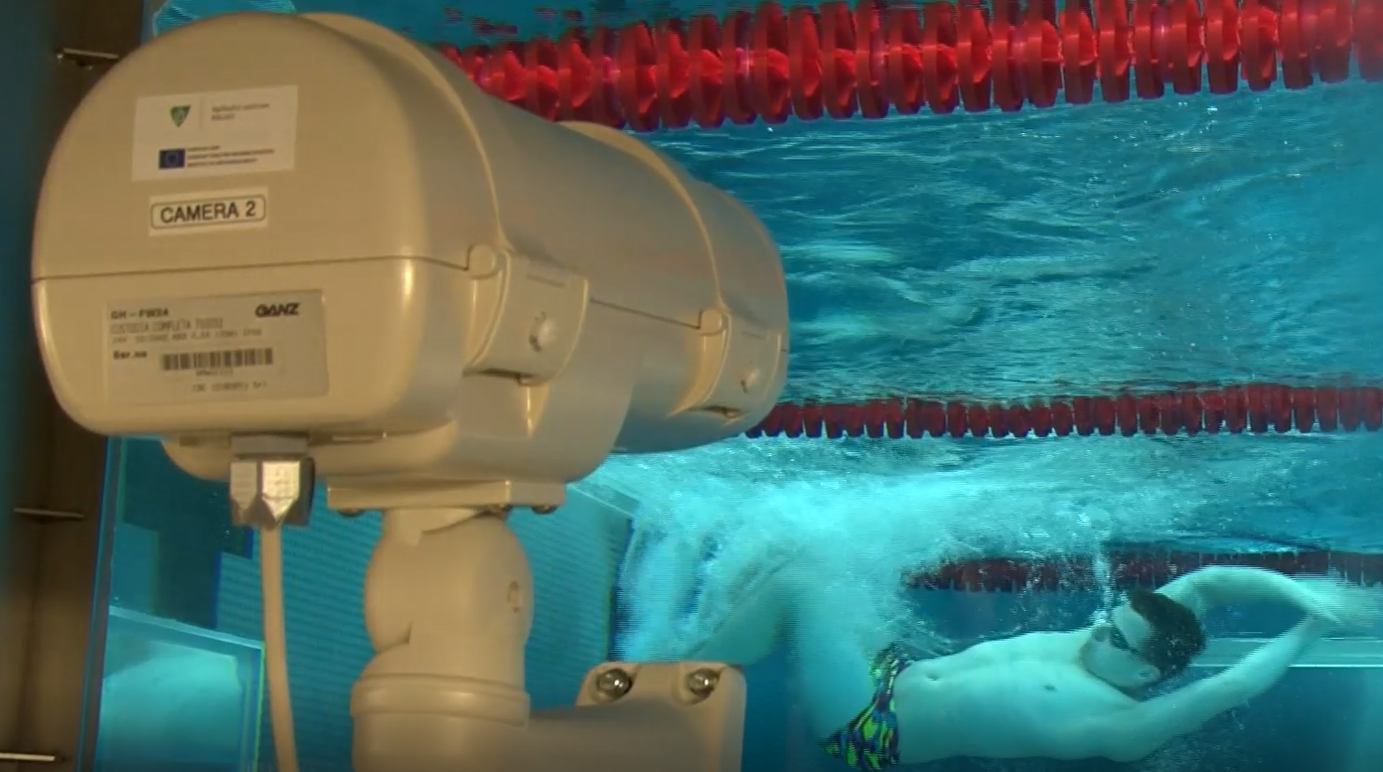
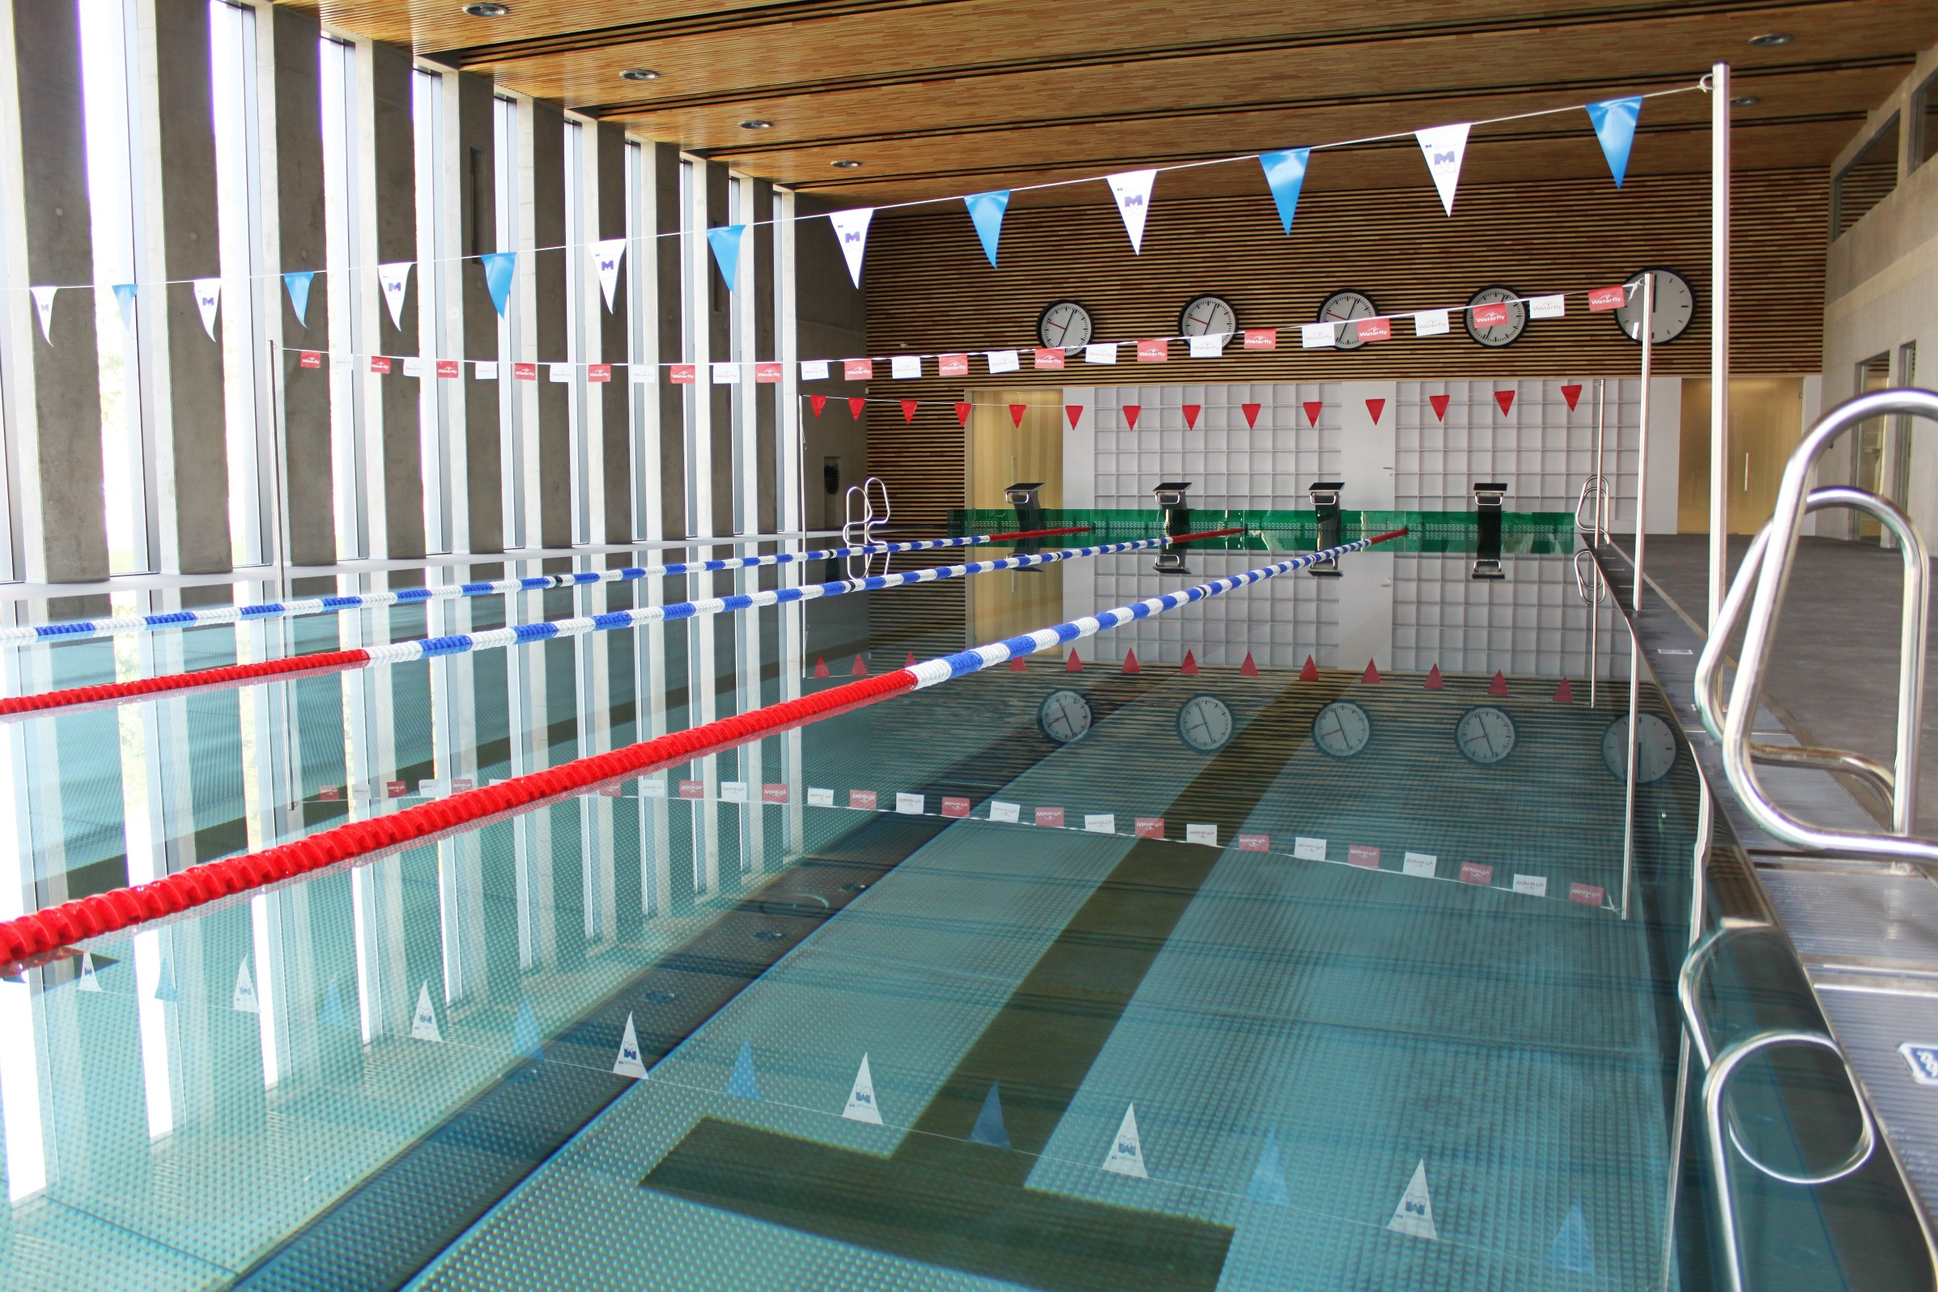
Swimming pool
Swimming pool 25 m
  4 widened lanes
  7 mirror windows with high-frequency cameras
Other pools
  Small swimming pool
  Whirlpool bath
Swimming Ergometer (Biokinecs)

Slide 5
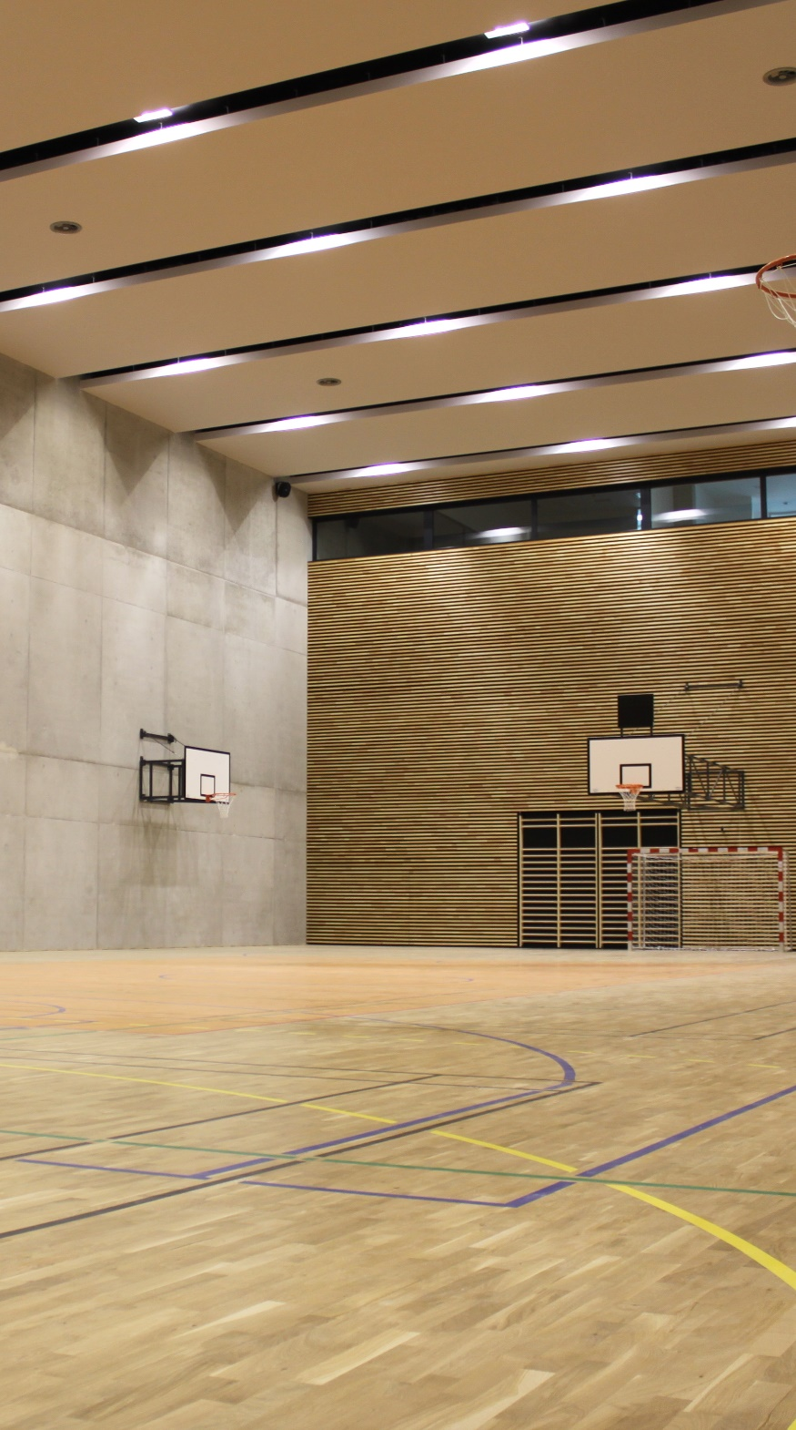
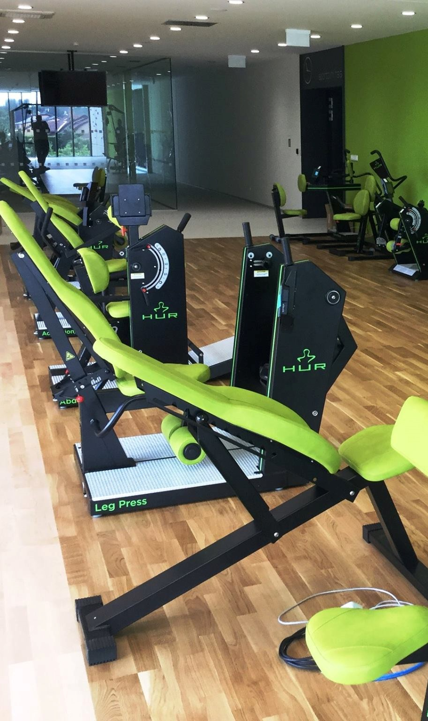
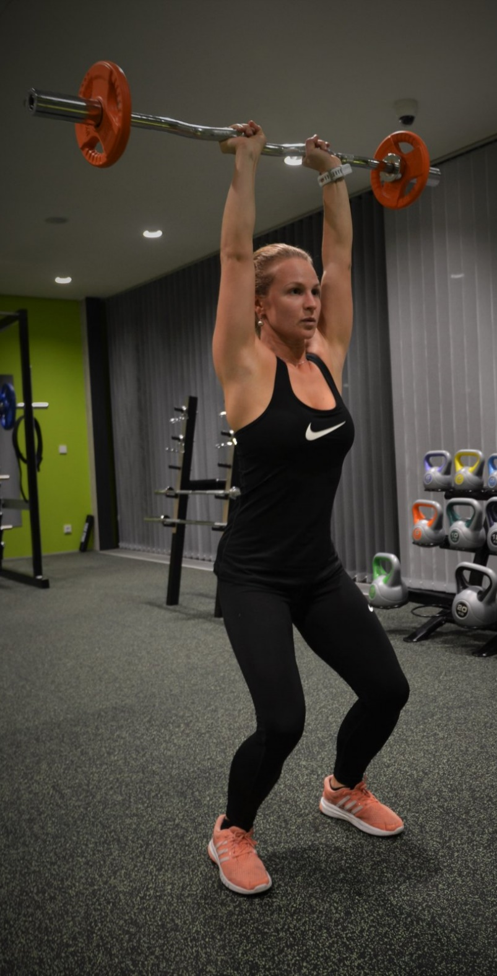
Gyms, fitness centre, movement studio …
Specific rooms:
Sports hall
Fitness centre
Gymnastic hall (climbing wall, trampoline)
Skiing simulator
Multifunctional movement studios

Slide 6
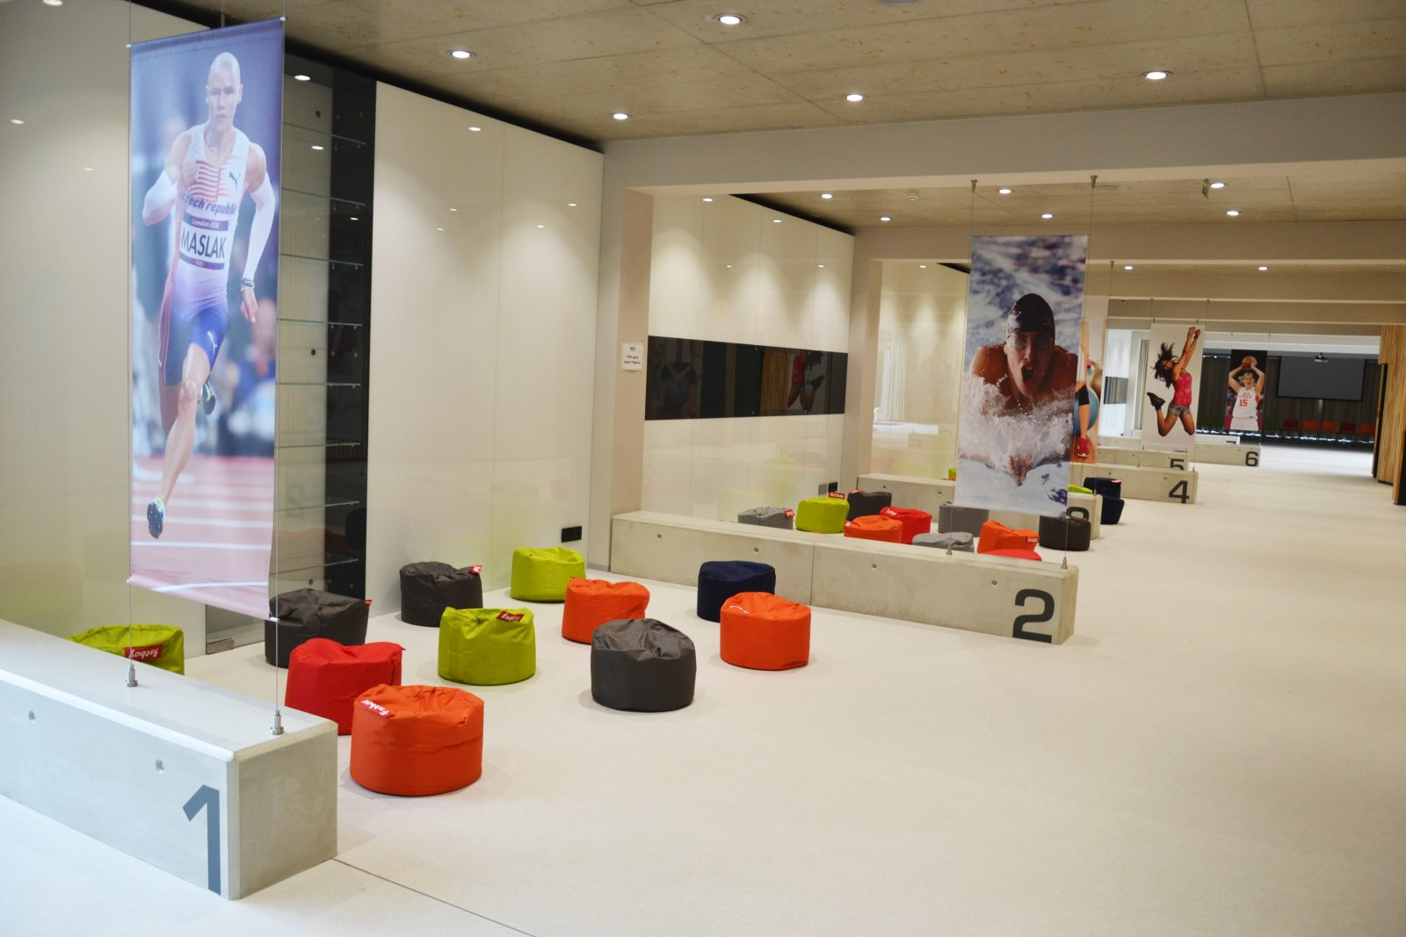
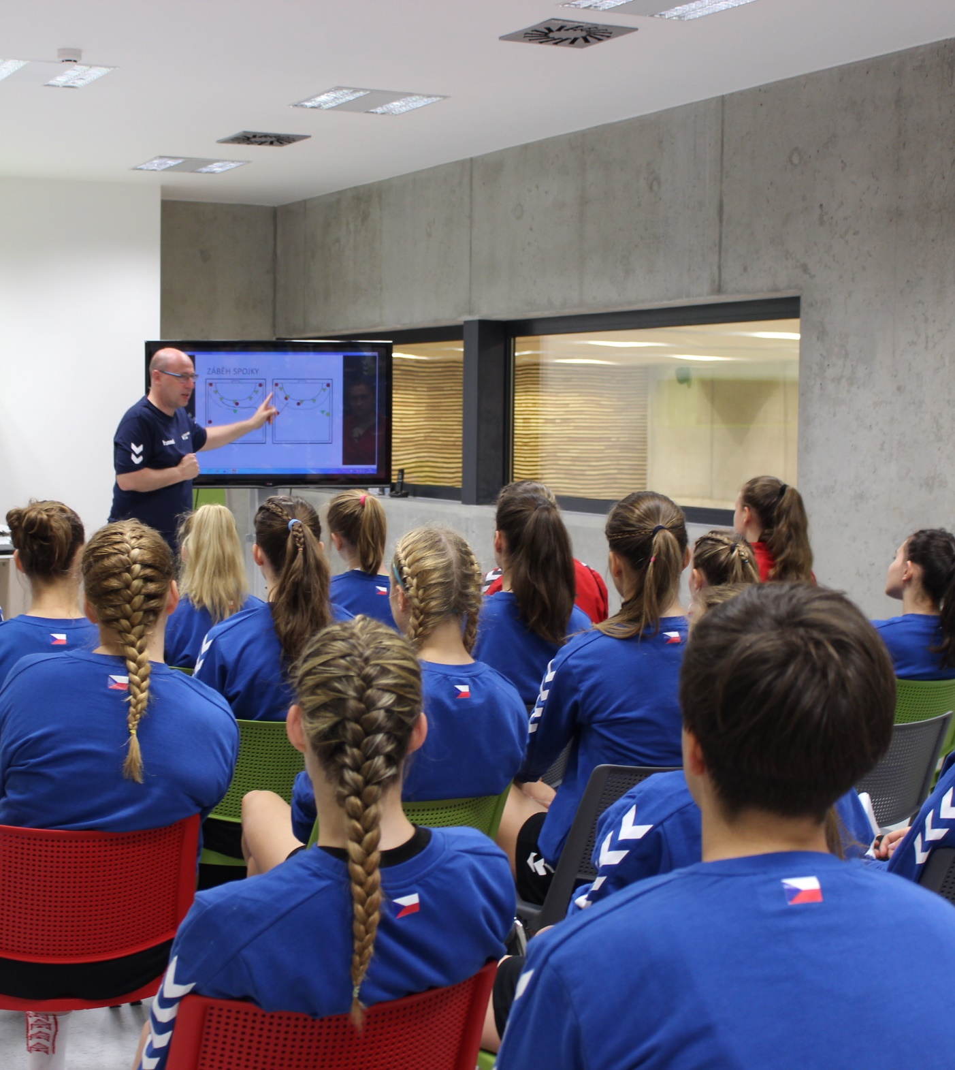
Lecture halls
- lectures, workshops, facilities for teams

Slide 7
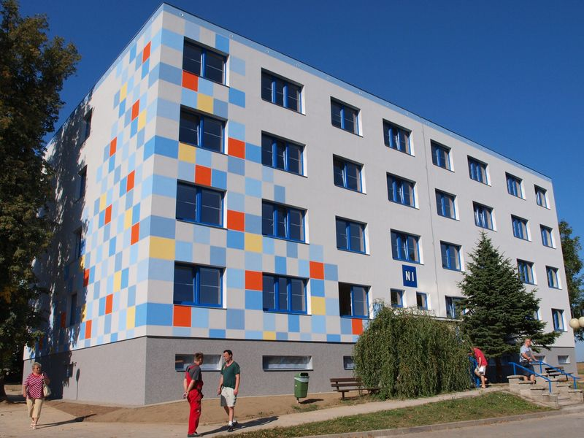
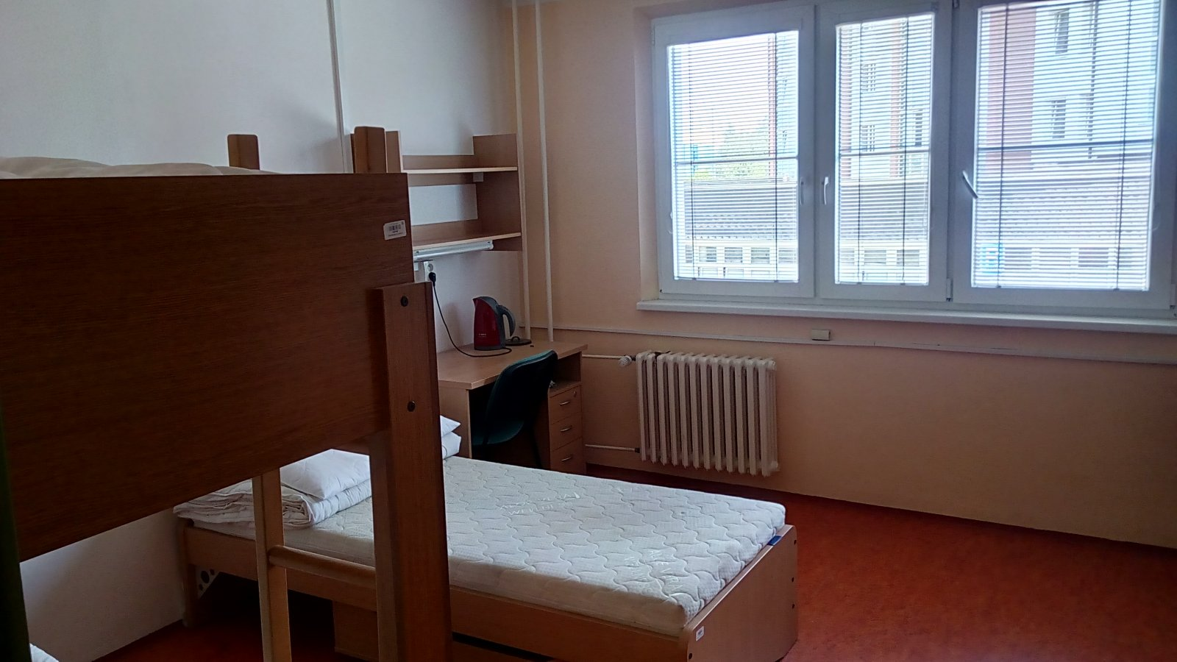
Accommodation
University campus
7 three-bed rooms and 1 twin room with bathrooms .
Rooms for coaches.
Possibility to extend booking to meet requirements.

Slide 8
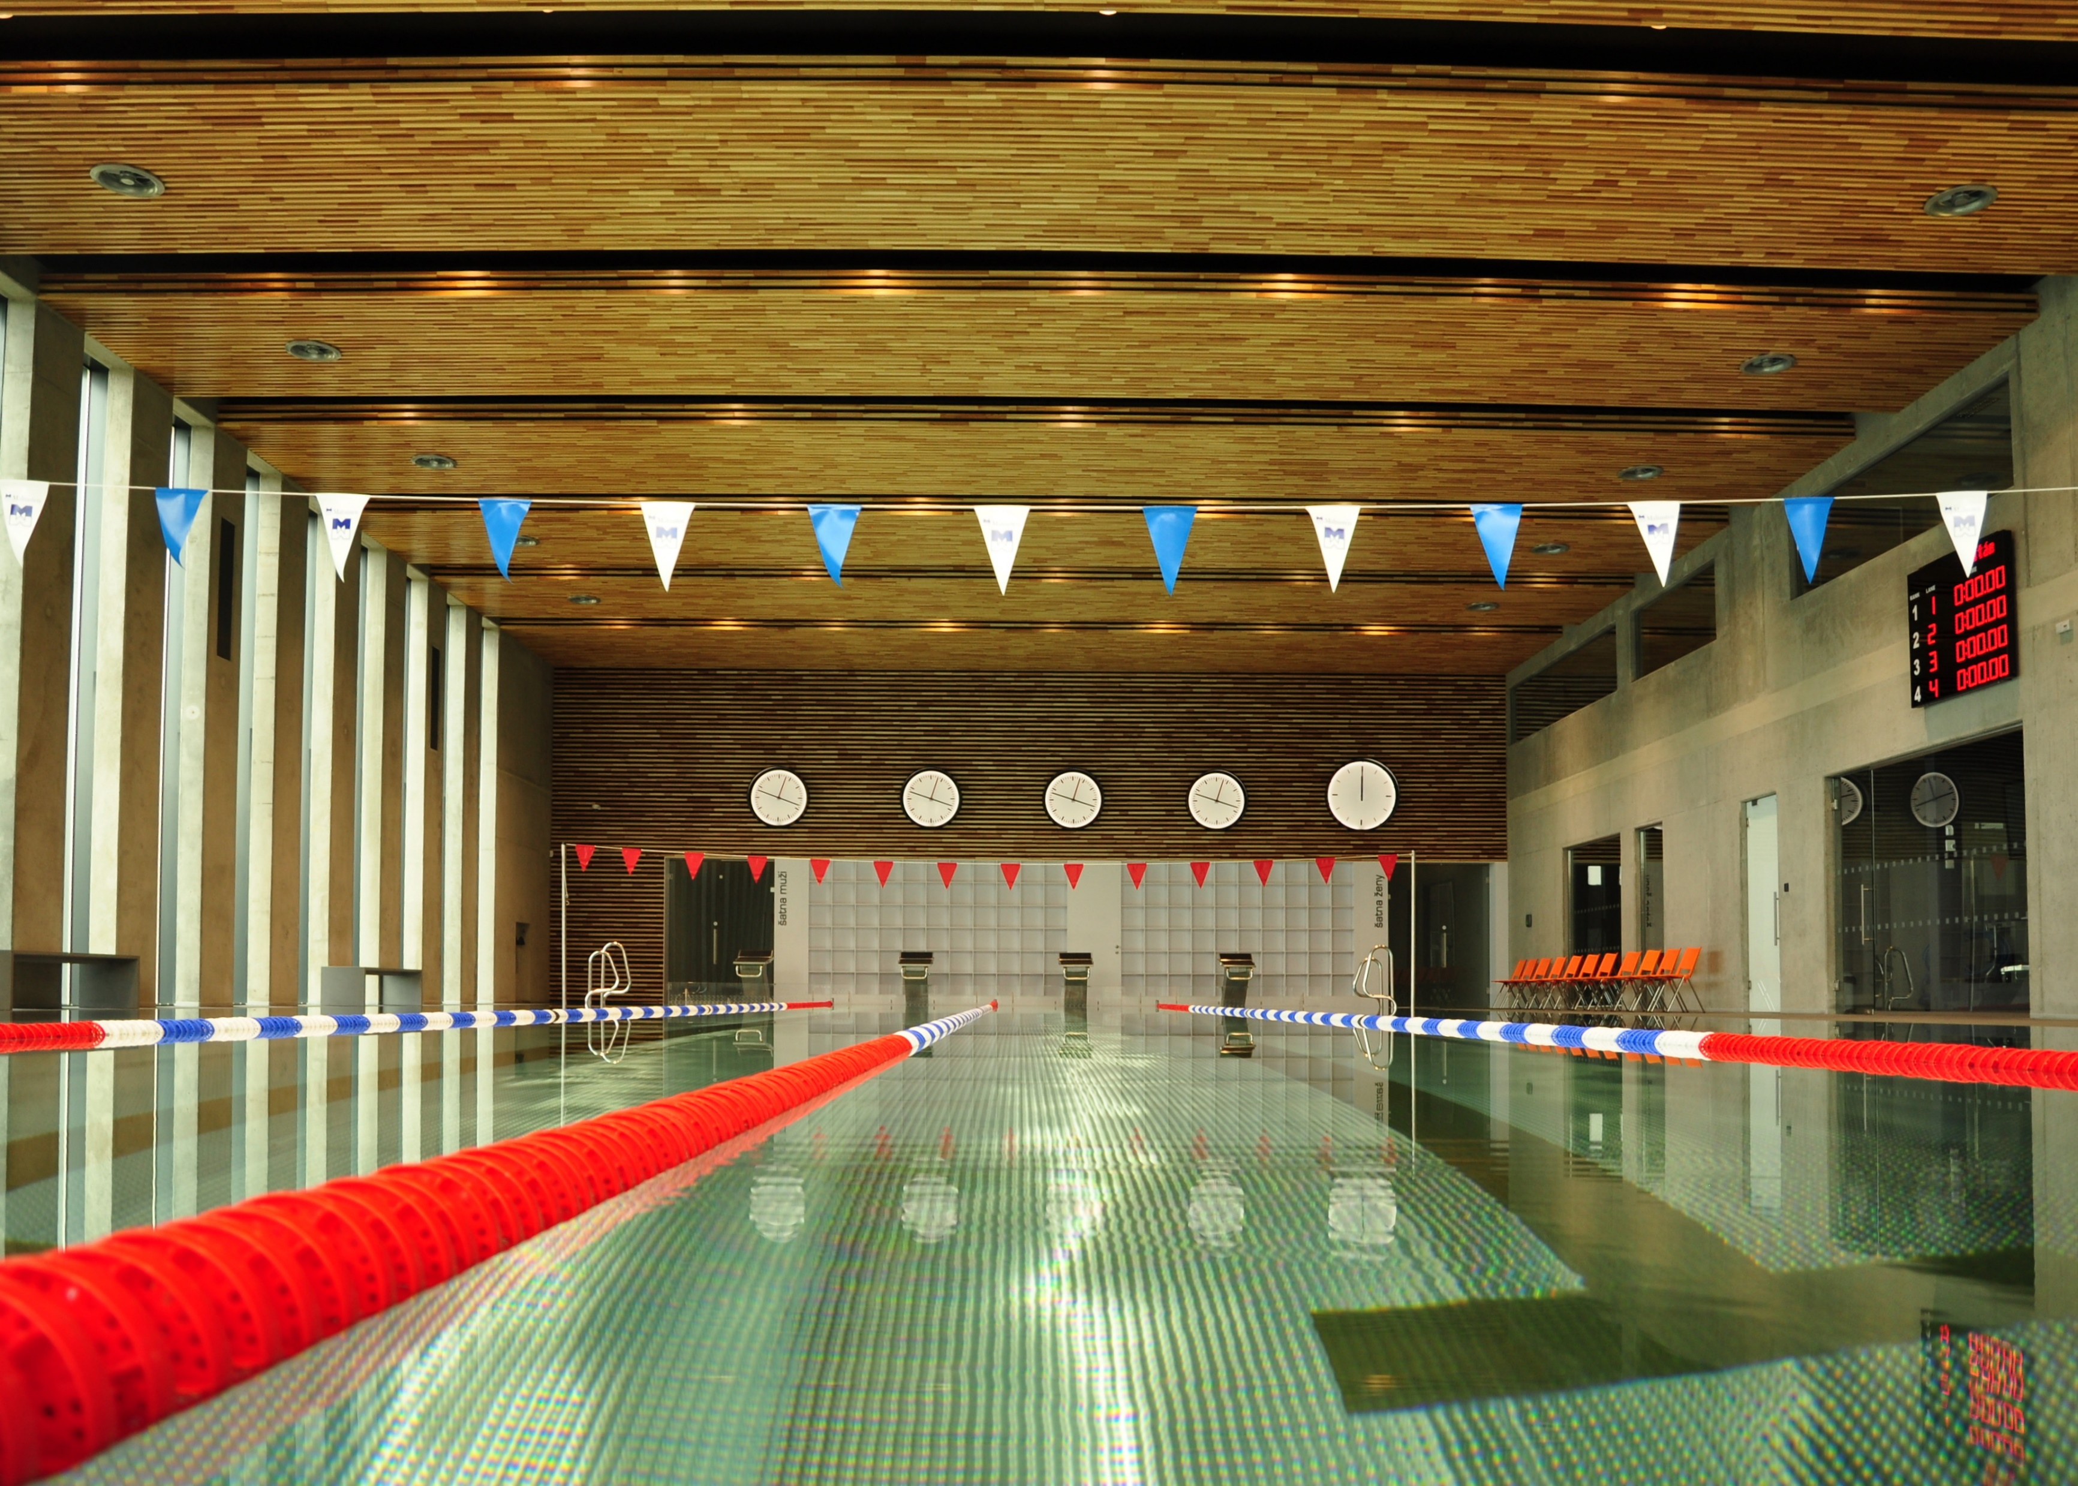

We look forward to meeting you

